Slide 1
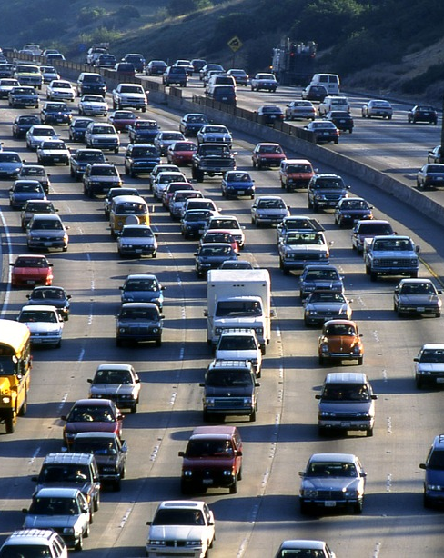
Highway Amenities Prediction
Team 1
Notes:
To change the image on this slide, select the picture and delete it. Then click the Pictures icon in the placeholder to insert your own image.

Slide 2
Business Case
Problem Statement:
Identify the need to develop correct highway amenities for interstate drivers, by reducing waste and building of unnecessary amenities.
Solution Offered
Employ predictive analytics to interpret drivers’ preferences from coupon response data and help figure out what kinds of services drivers like most, by constructing best options that make trips better and increase profitability.

Slide 3
Methodology and Work Flow
Data Review
EDA
Feature Engineering
Model Review, Comparison & Interpretation
Recommendations

Slide 4

Data Review

Slide 5


Data Review
Dataset:
id: unique number giving to the driver doing the survey
destination: No Urgent Place, Home, Work
passanger: Alone, Friend(s), Kid(s), Partner (who are the passengers in the car)
weather: Sunny, Rainy, Snowy
temperature:55, 80, 30
time: 2PM, 10AM, 6PM, 7AM, 10PM
coupon: Restaurant(<$20), Coffee House, Carry out & Take away, Bar, Restaurant($20-$50)
expiration: 1d, 2h (the coupon expires in 1 day or in 2 hours)
gender: Female, Male
age: 21, 46, 26, 31, 41, 50plus, 36, below21
education: Some college - no degree, Bachelors degree, Associates degree,..
occupation: Building & Grounds Cleaning & Maintenance, Farming Fishing & Forestry
.
.
.
Y: 1, 0 (whether the coupon is accepted)
Highway operation dataset
10K Records
1 – Outcome -> Y
25 Columns
24 – Predictors
Result – Prediction -> Y

Slide 6
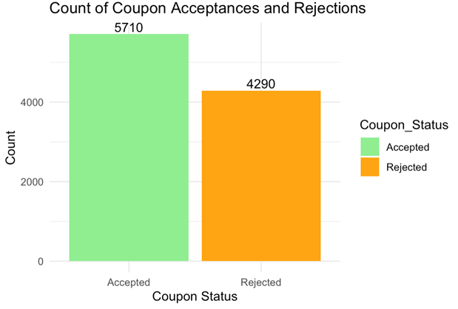
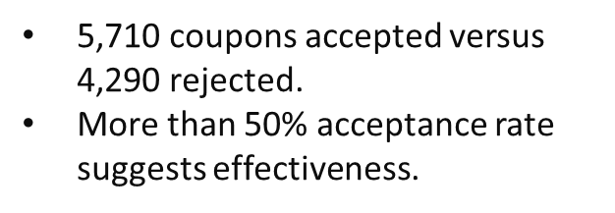
EDA

Slide 7
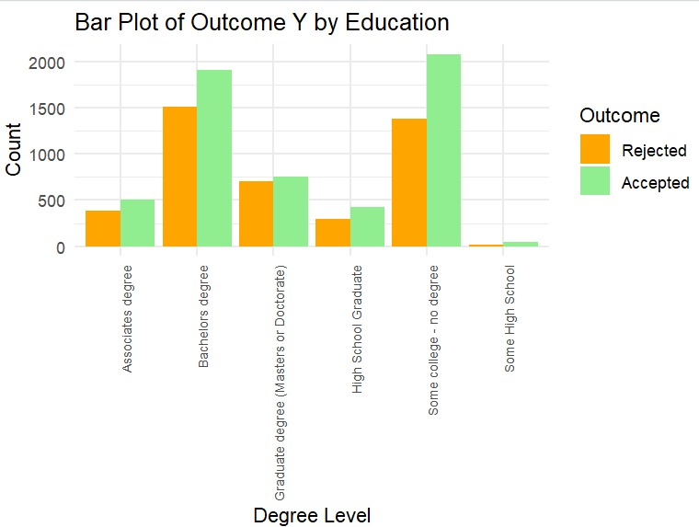
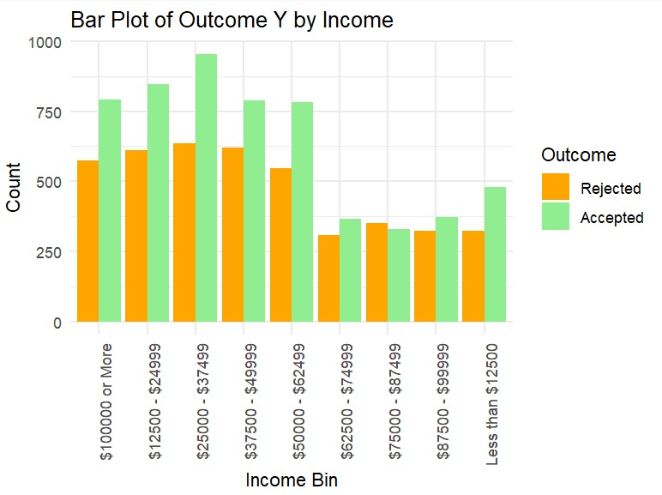
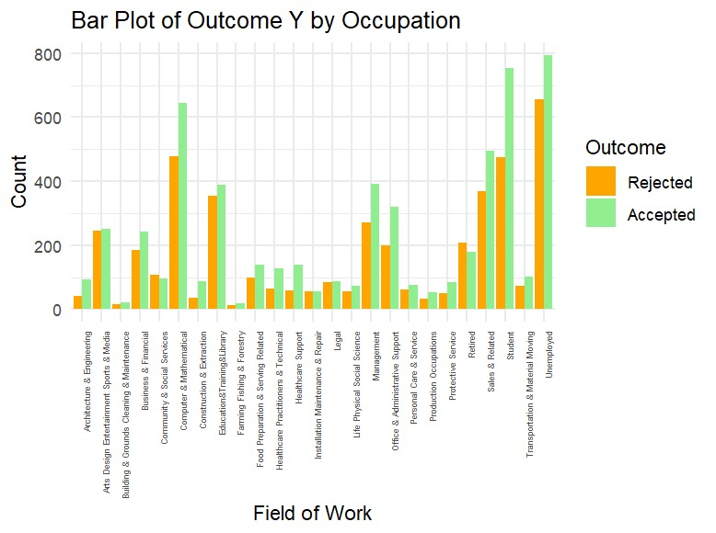
EDA-I
Occupation group possibly related to ‘Unemployed' shows highest acceptance, nearing 800.
High acceptance occupations could be targeted more aggressively.
Occupation emerges as a significant factor influencing outcomes.
Highest coupon acceptance rates observed among individuals with "some college - no degree.“
Bachelor's Degree Holders are Second-highest acceptance rate of coupons.
High school degree is not important
Correlation observed between income levels and acceptance/rejection of Outcome Y.
Acceptance counts increase with income, peaking at "$25,000 - $37,499" bracket, nearing 1,000 counts.

Slide 8
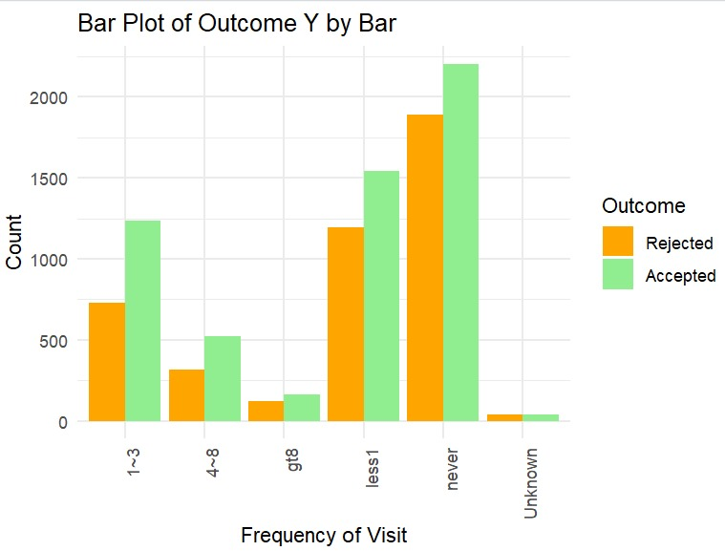
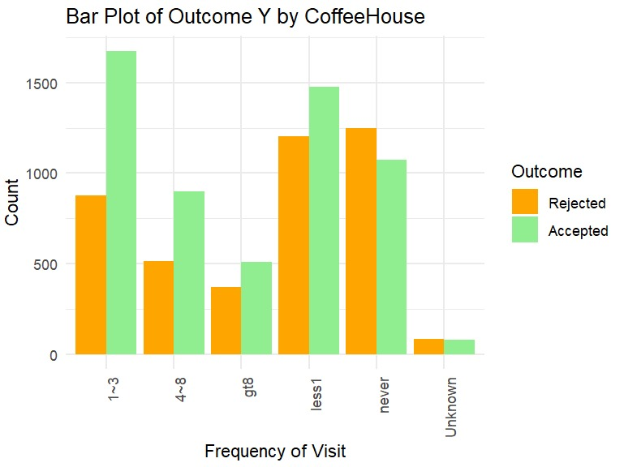
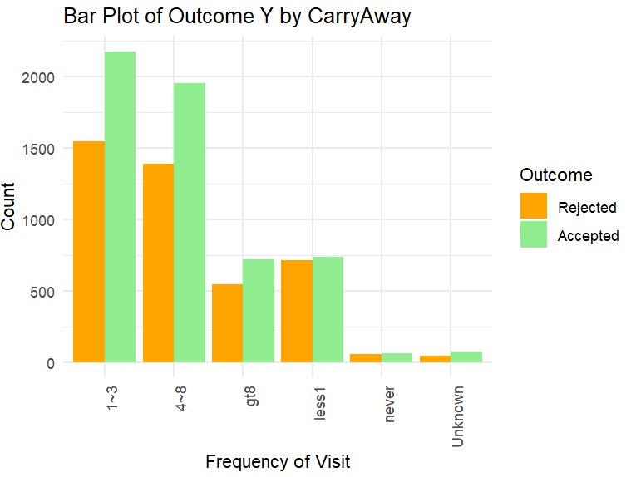
EDA-II
”1~3" and "4~8" categories show significantly higher counts for both acceptance and rejection.
Less frequent interaction with "CarryAway" linked to lower acceptance and rejection counts.
1~3 frequent users may be more receptive.
”1~3” users shows the highest count to accepted
"Never" and "Unknown" categories show lowest counts for both acceptance and rejection.
”never" group has highest count for both accepted and rejected outcomes.
"1-3" group shows very low counts for both acceptance and rejection, expected due to lack of decision-making independence.
" never" could be primary target for marketing strategies or interventions related to Outcome Y, given their high engagement.

Slide 9
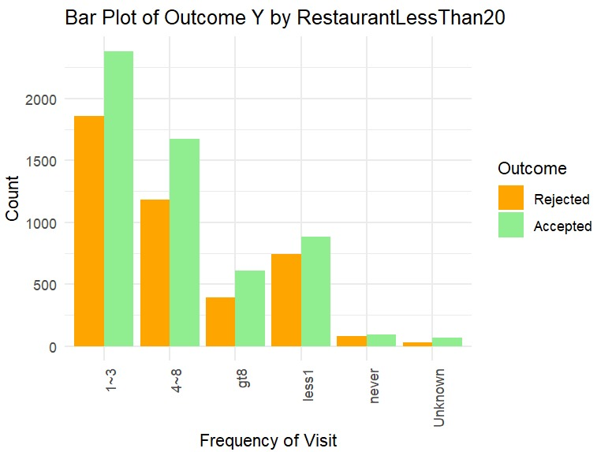
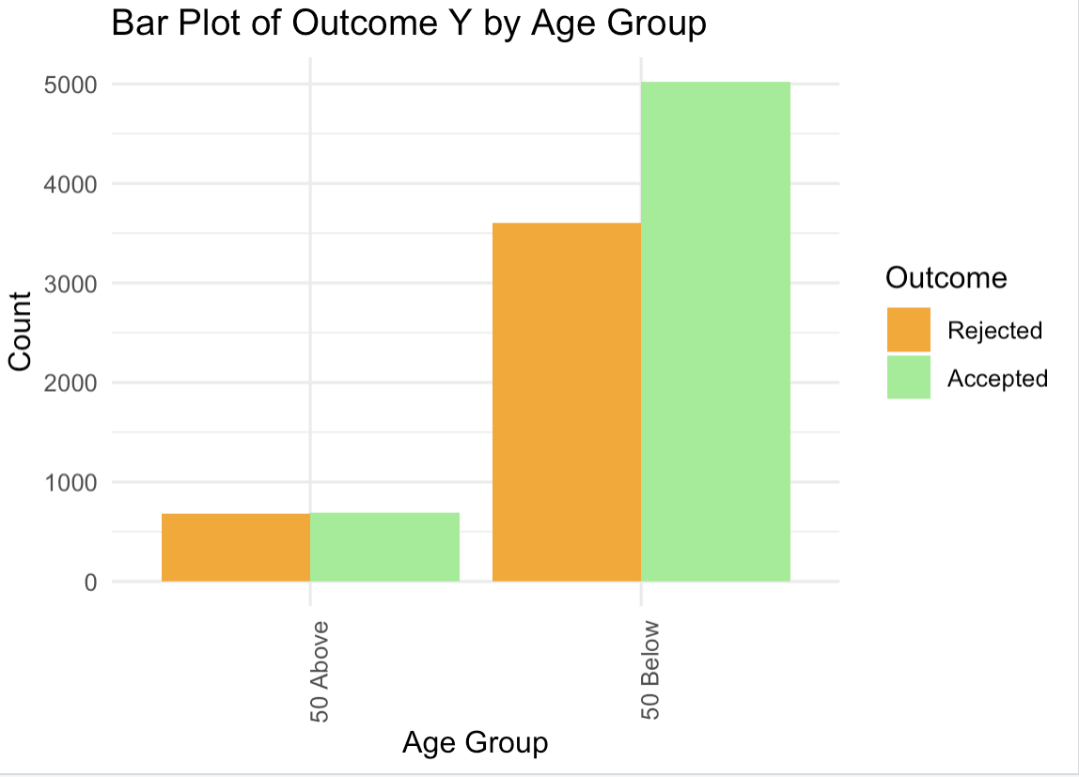
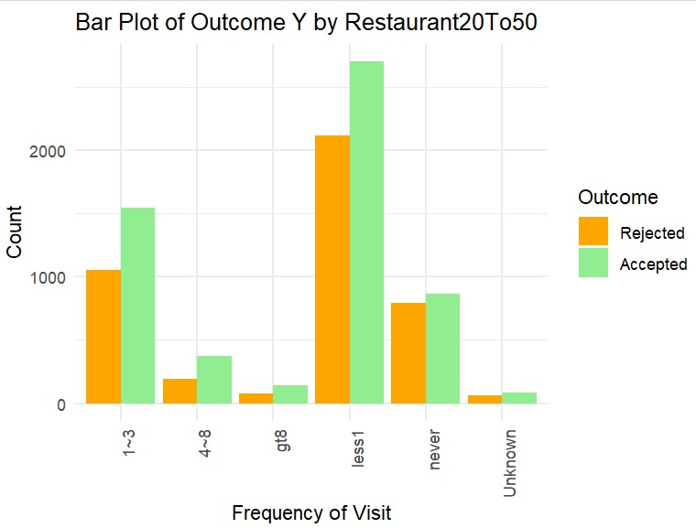
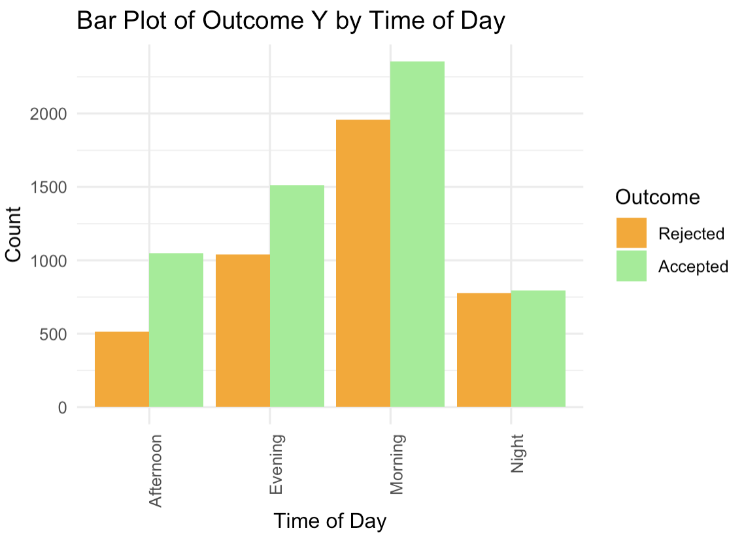
EDA-II
“less1 times" frequency category shows highest acceptance count, indicating strong engagement with Outcome Y.
Morning time slot shows highest number of acceptances, exceeding 2,000 counts.
Both Afternoon and Night show more rejections than acceptances, indicating less favorability or relevance during these times.
Frequency category "1-3 times" shows significantly high acceptance count, suggesting strong engagement.
Increase in frequency of visits correlates with decline in both acceptance and rejection counts.
"Never" and "Unknown" categories exhibit very low counts for both acceptance and rejection.
"Above 50" age group exhibits substantially higher acceptance count and very few rejections.
"Above 50" age group shows overwhelming preference for acceptance, indicating strong resonance with Outcome Y.

Slide 10
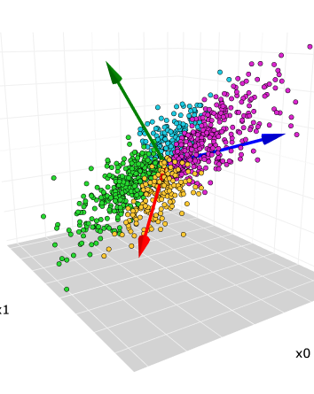
Feature Engineering

Slide 11
Feature Engineering
Converted characters to factors.
Created a data frame consisting of columns of interest.
Filled blank data with an Unknown string for CarryAway, Bar, CoffeeHouse, Restaurant20To50, RestaurantLessThan20
Divided Age Group into 2 parts 50 Above and 50 Below.
Converted Time into 4 categories: Morning, Afternoon, Evening, and Night.

Slide 12

Feature Engineering
Before (highway_data)
Existing Columns
After (highway_data)
Selected Columns
Time
AGE
Bar, Coffee, Car away, Restaurant columns
7AM, 10 AM
2 PM
6 PM
10 PM
50 Above
50 Below
Morning
Afternoon
Evening
Night
50 Above – 1378
50 Below – 8622
Added “Unknown” to blank columns
Time of Day

Slide 13
Model Review, Comparison & Interpretation
This Photo by Unknown Author is licensed under CC BY-SA-NC

Slide 14
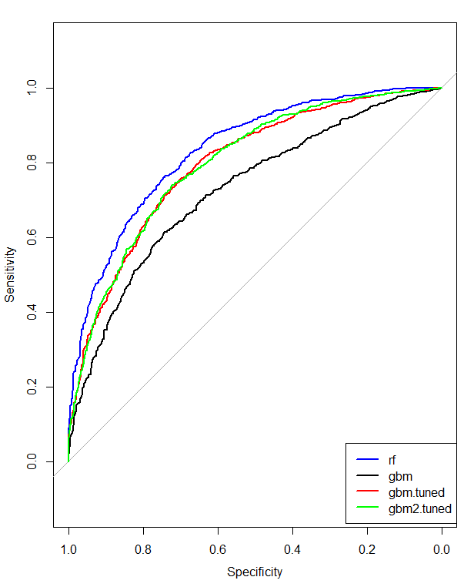
Model Review
Sr No | Model Name | Accuracy | F1 score
1. | Logistic Regression | 55.51% | 64.43%
2. | Random Forest | 76.06% | 80.21%
3. | Gradient Boosting | 66.65% | 72.54%
4. | GBM Tuned_1 (cross-validation = 20) | 73.20% | 75.66%
5. | GBM Tuned_2 (cross-validation = 20, repeated 5 times) | 71.80% | 74.15%

Slide 15
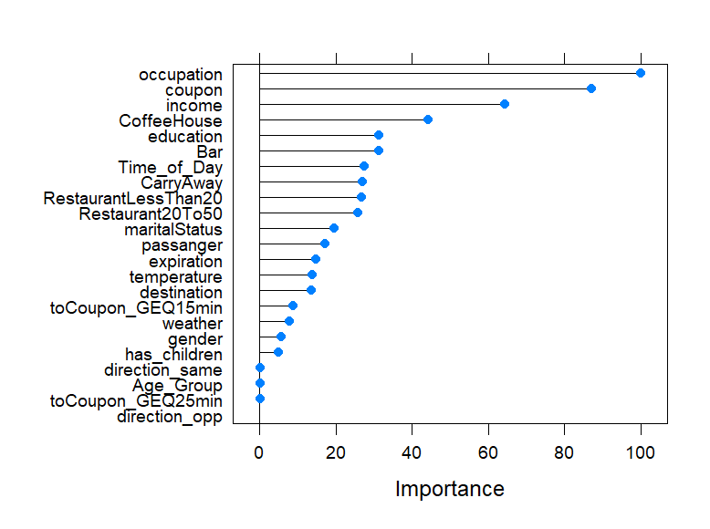
Selected Model and Feature of Importance
Selected Model | Random Forest (rF) | Accuracy = 76.06% | F1 Score = 80.21% | 80:20 Split
Amenities:
Coffee House
Bar
Carry Away
Restaurant <20$
Restaurant $20-$50
Important Features:
Occupation
Coupon
Income
Education
Time of Day
Top Predictors:
Occupation
Income
Education
Insights:
Economic and social status play a role in amenity preference
Preferences vary with the time of day, hinting at potential peak hours for specific amenities.

Slide 16

Implications &
Recommendations
This Photo by Unknown Author is licensed under CC BY

Slide 17
Implications and Recommendations - I
Important Variable | Implications | Recommendations
Occupation | The feature occupation shows the highest importance, suggesting that a driver’s job significantly influences whether they accept the coupon and hence their amenity preferences | Establish partnerships with affordable chains or local vendors that can provide cost-effective options. Offer special discounts or loyalty programs for repeat customers to encourage ongoing patronage.
Coupon | The coupon and is also highly influential in this dataset, which can show the preference for the amenity | Since coffee houses are popular, providing a premium coffee experience could be a significant draw. That will be a good advice that building more coffeehouse with a range of options from standard brews to specialty drinks
income | Showing that financial considerations affect amenity preferences | Collaborate with popular mid-range amenity chains or support local eateries that can provide quality product at prices that align with middle-income budgets.

Slide 18
Implications and Recommendations - II
Important Variable | Implications | Recommendations
Education | Education is the fourth important factor influence. | Most people are around bachelor degree and less, we can make coupon rule more straightforward and directly.
Time of day | The acceptance of a coupon varies with the time when the driver is traveling. | Consider the operational hours of the amenities. Based on the bar chart, we recommend the operational time is from 7am to 6pm

Slide 19
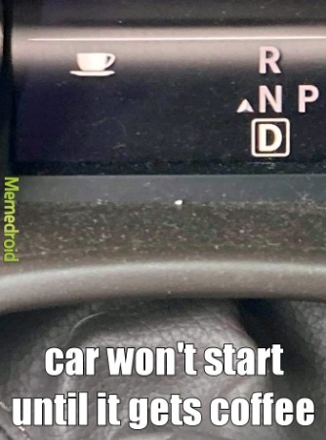
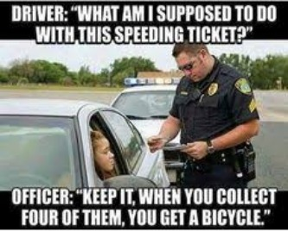
Thank you

